Slide 1
Helping Hand Final Demo
Team Members: Garðar Benediktsson, Lizzy Jackson, Harrison Dinius, Gabrielle Stoney, Jason Hansen

Slide 2
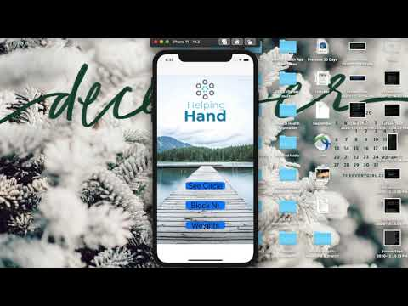
Sprint Demo Video
https://www.youtube.com/watch?v=zxYrAdjjHSw&feature=youtu.be

Slide 3
Garðar Benediktsson
The app (Xcode)
The main build
The app UI
Menu Screen
BlockNr View
Weights View
ShowCircle View
Notifications
Local and remote
Merging projects
Was a helping hand for group members
Documents
Ideas and solutions

Slide 4
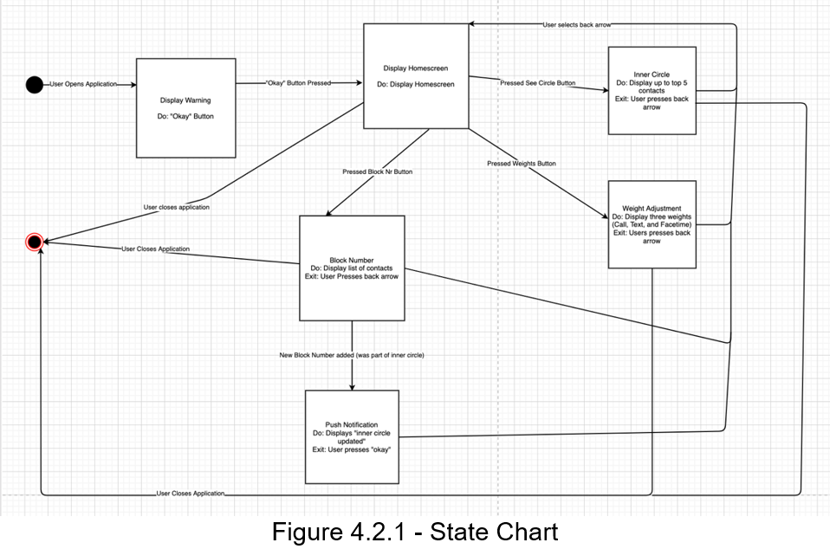
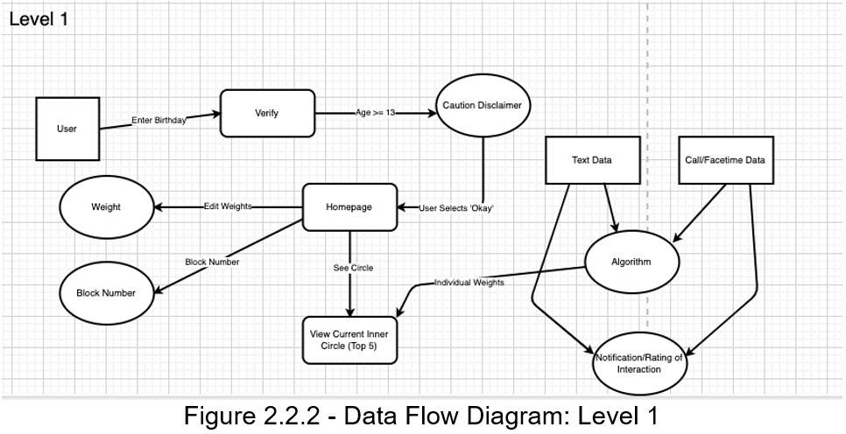
Lizzy
Created and edited SDD and SRS, to create a presentable version for the final sprint
Created, then redrew design diagrams to be better understandable (used computerized design for this)
Any comments from Dr. Akbas and Juan were reviewed and used to improve language
Helped team members to research possibilities for allowing push notifications
Helped team members with various issues
Examples: finding a different way to get access to communication information, ideas and solutions
Merged progress and ideas into documents to properly communicate ideas, solutions, and discussion to the costumer

Slide 5
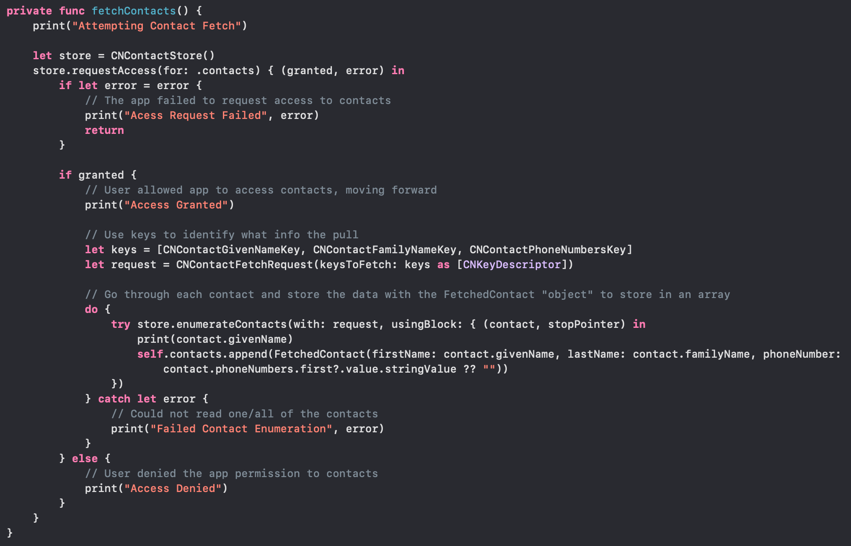
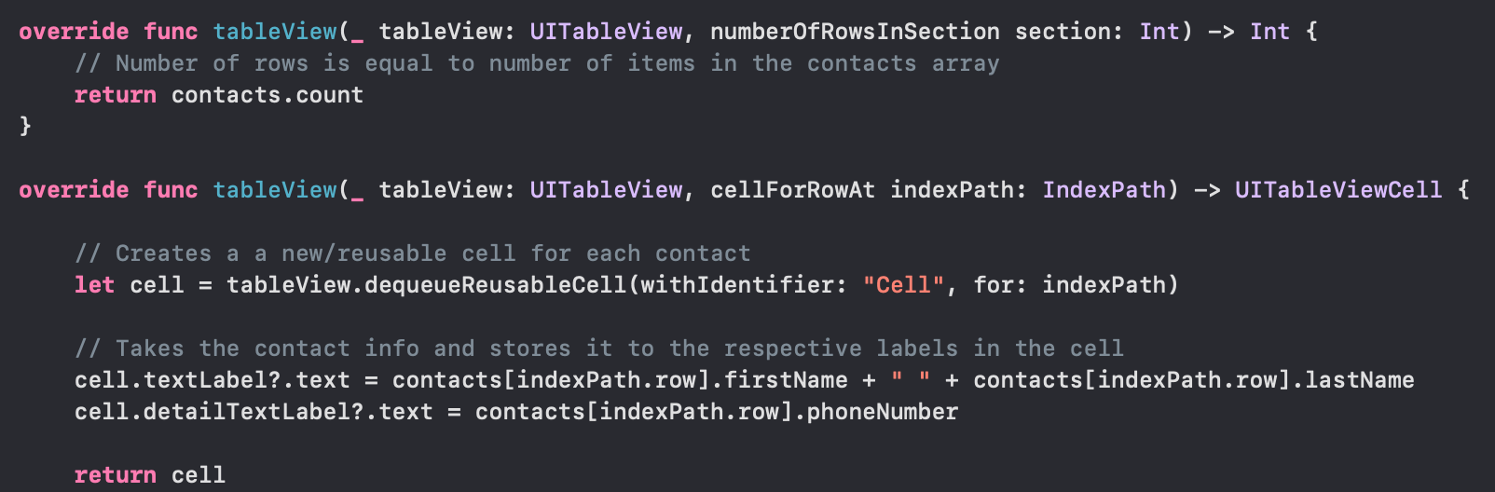
Harrison
Block Number View
Pull contacts from the user's iPhone
Permission to access contact data
Research conducted
Cloud service for accessing data
How to work around Apple's privacy policy for this semester
Extract contact data logs
iBackup Viewer was used to export call/Facetime history to a csv
Python script for pulling message history not completed
Aided in documentation creation
Also logged meeting notes on GitHub

Slide 6

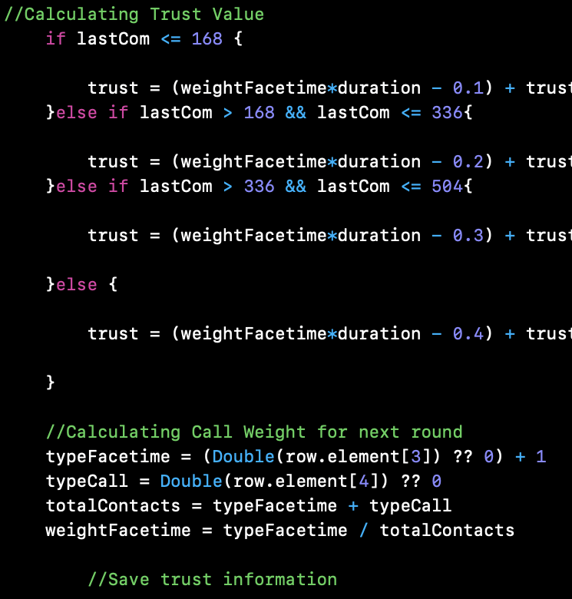
Gabrielle
Algorithm
Trust = (FOM*DOC – time) + trust0
Trust0 = FOM*DOC

Slide 7
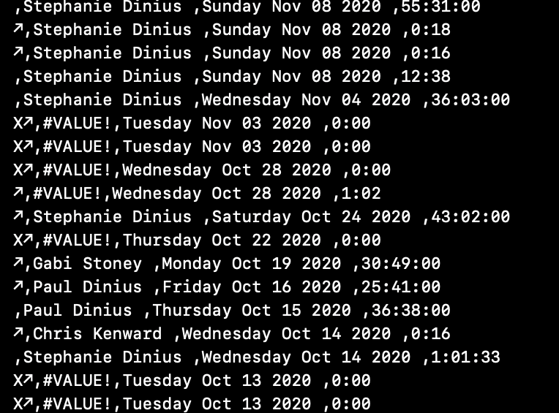
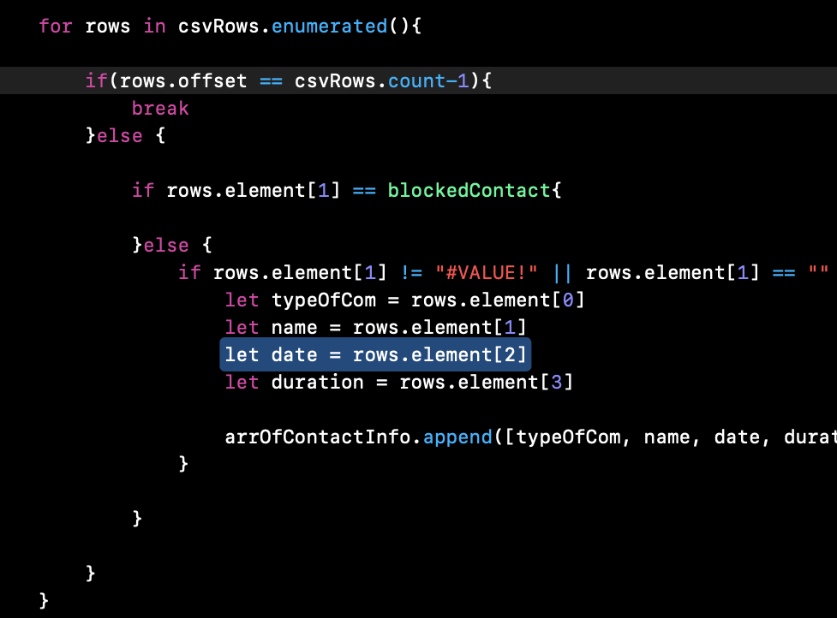
Gabrielle – File Reading

Slide 8
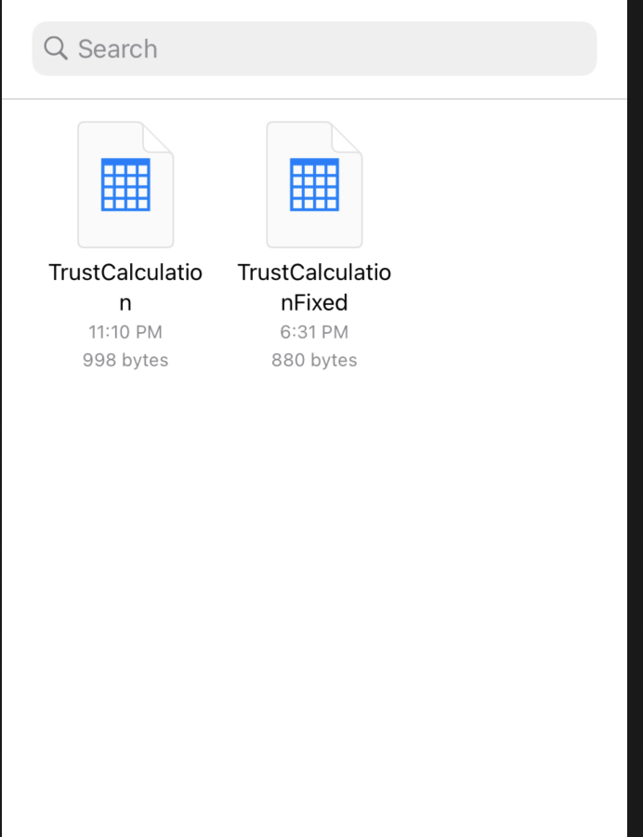
Gabrielle - File Read Cont.

Slide 9
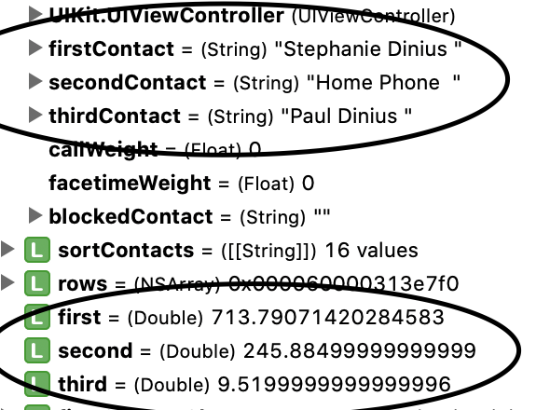
Gabrielle - Results

Slide 10
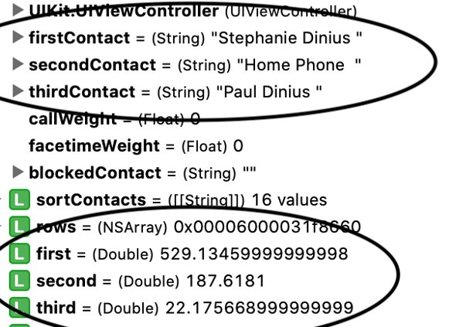
Gabrielle - Results

Slide 11
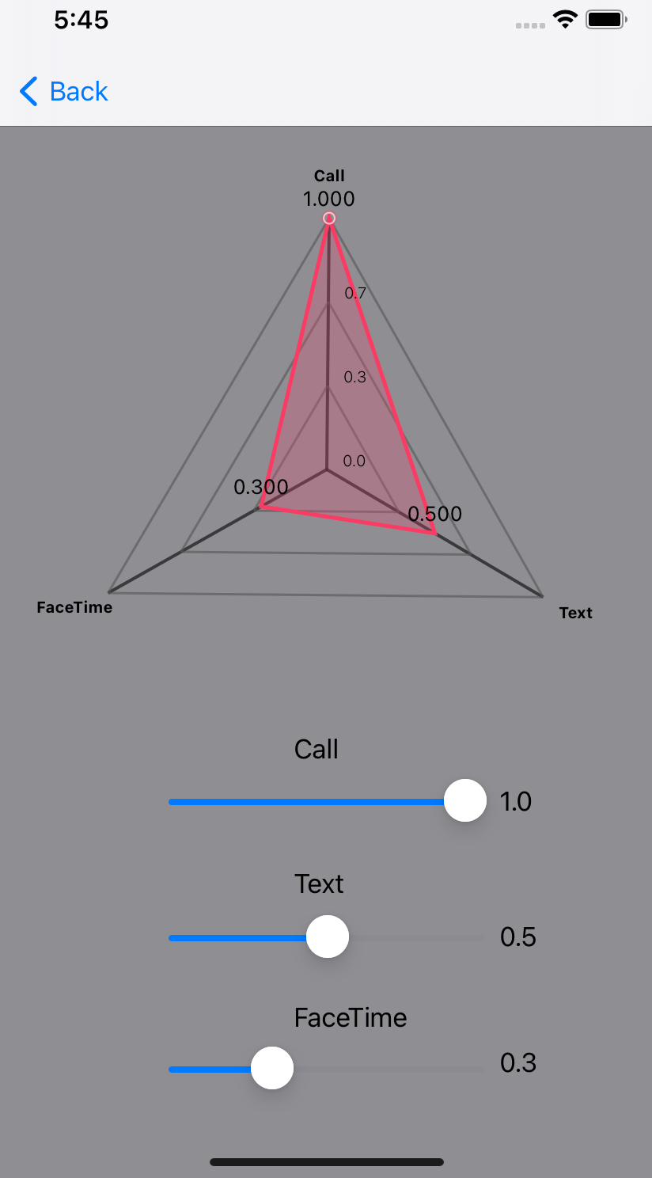
Jason
Xcode contribution
Weights view: Interactive Radar Chart
Uses IOS charts framework
Debugging
Research
Social Brain Hypothesis + related journals
Xcode
IOS Charts
Programs to extract communication logs
Tested and found some with .csv results (iMazing, CopyTrans)
Documentation help
SRS, SDS, Test plan

Slide 12
Sprint Review and Retrospective
What's Left:
Implement a database
Implement notifications – surveys
Integrate block number
Integrate weights display
Investigate Cloud Computing
What we need:
Funding for Apple Developer's license (notifications and surveys)
Funding for cloud computing service (algorithm and/or pulling data)
Strengths and Weaknesses
Our team had solid communication and frequent meetings
Prioritize research so as many issues as possible may be avoided later
Designate a clear Scrum Master

Slide 13
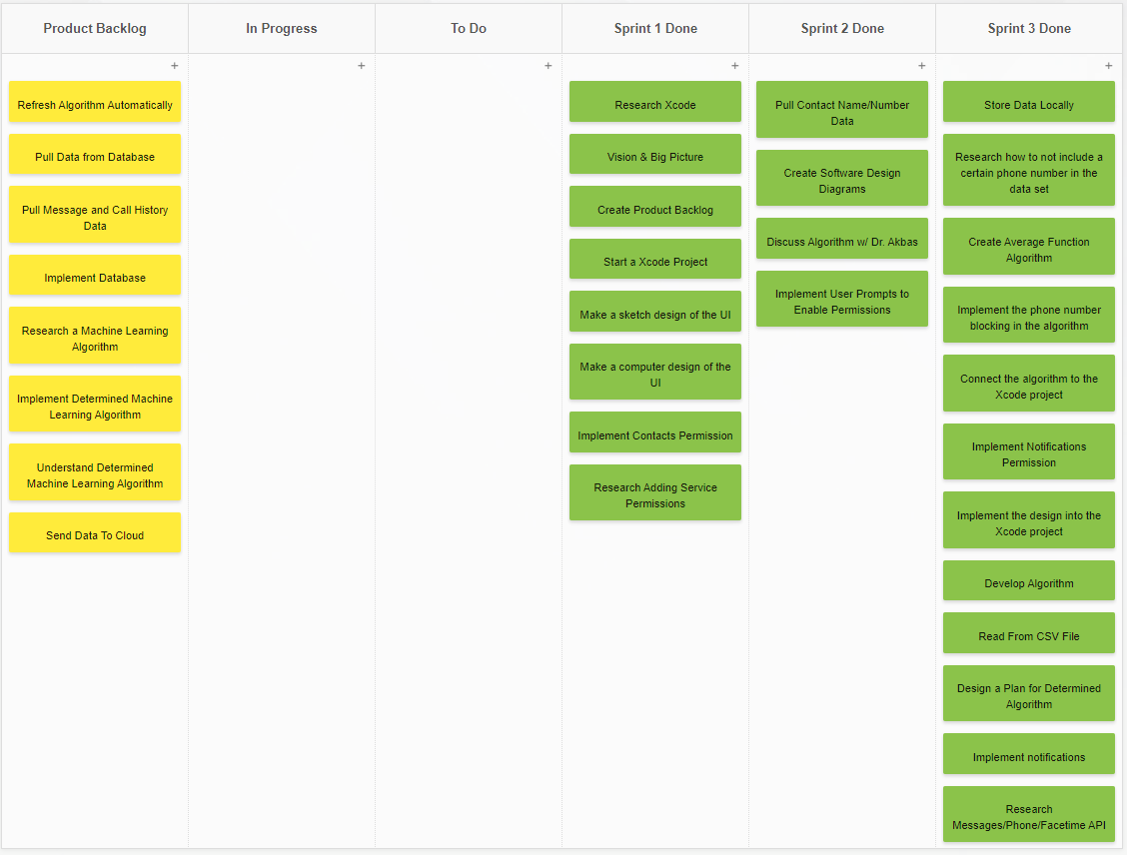
Scrum Board
Sprint 3 was by far our strongest Sprint in terms of objectives completed
Considerable work remains in the Product Backlog tasks
This is not accounting for new tasks that will need to be made next semester

